Slide 1
Week 5 Final
Denzil Stavinoha
CST 499
Joseph Rangitsch
24 August 2024
Notes:
Hello everyone and welcome to my week five final project.

Slide 2
Agenda
Introduction
SRS Document
UML Design
Landing, Login, Enrollment pages
SQL Database
Website Preview
Closing words
Notes:
Here we will discuss the student portal system as well as its supporting documents to get a better look at its interworkings.

Slide 3
Introduction
Simplified course registration and management
User friendly design
Secure data handling
Real-time updates
Notes:
This project aims to develop a comprehensive online platform that simplifies course registration and management for students. By focusing on a simple user-friendly navigation, secure data handling, and real-time updates, the system will enhance the overall experience for both students and administrators. Today, we will walk you through the key aspects of our project, including the design and a preview of the final product.

Slide 4
SRS DOCUMENT
Course availability and waitlist functionality
Core feature:
User registration
Course enrollment
Management
Security measures for data protection
Scalable architecture
Device and browser compatibility
Notes:
The SRS for the Student Portal System provides a detailed blueprint for building a robust platform that facilitates user registration, course enrollment, and profile management. It emphasizes the importance of secure data practices and a scalable system architecture that can accommodate increasing user demands. The document also outlines the need for cross-device compatibility and real-time updates to ensure students have accurate and up-to-date information on course availability and waitlists.

Slide 5
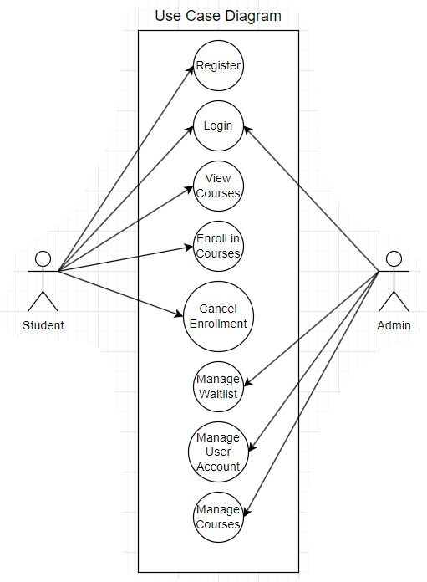
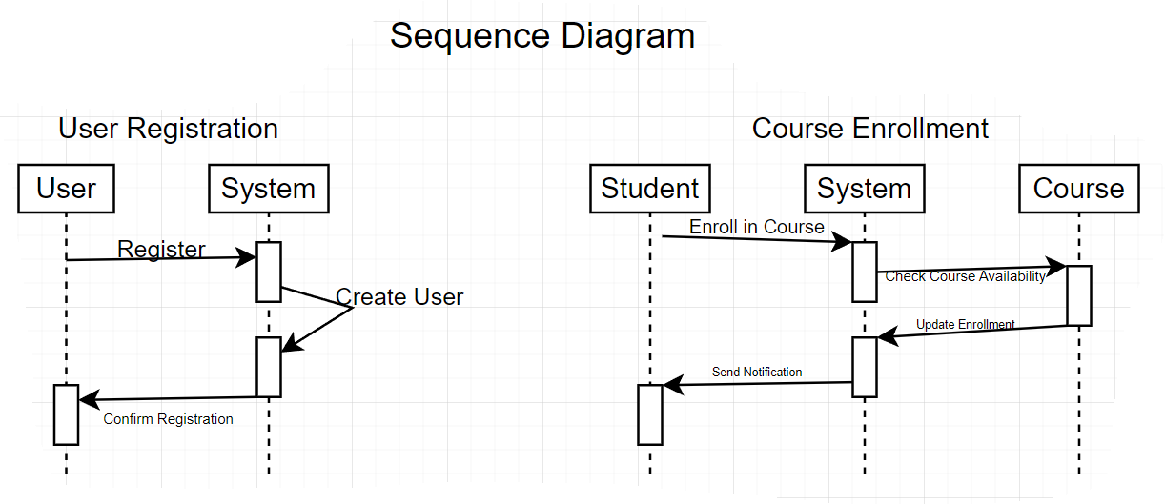
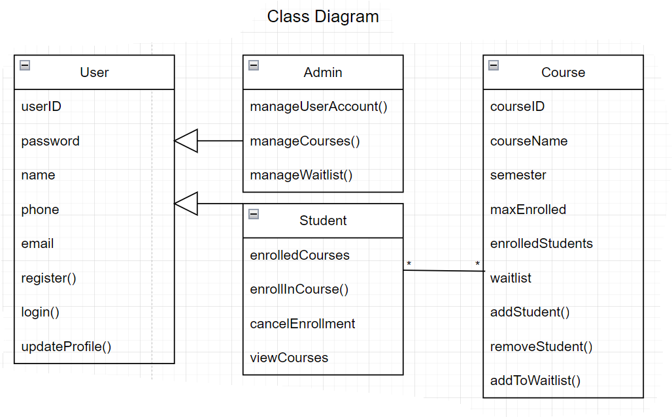
UML Designs
Notes:
As you can see, we have a few of the UML Diagrams explaining the Student Portal System. Let's focus for a minute on the Use Case Diagram. The Student has access to register, login, view, enroll and cancel classes while the admin has access to login, and manage various areas of the website. While this may not reflect the final options the student and admin will have, it is a great visual aid to determine what the different type of users will be able to accomplish.

Slide 6
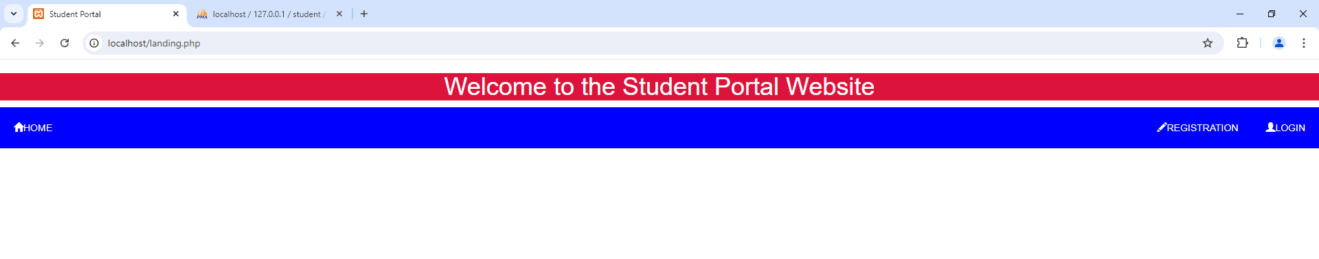
Landing, Login, and Enrollment
Simple
Focused
Notes:
We kept the landing page as basic as possible. We didn’t want there to be any confusion of what could be done or where you were. We took artistic design from the University of Arizona Global campus to give it a more professional and familiar look by keeping the same colors as well as button layout.

Slide 7
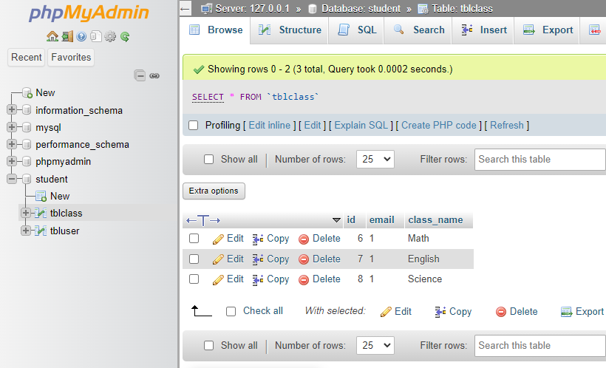
SQL DATABASE
Maintainability
Scalability
Notes:
For the basic mockup of the student portal system, we decided to use phpMyAdmin since it is incredibly easy to manage and scale. You can see we created the main database as well as supporting tables to hold each user and well as the classes the user signs up for.

Slide 8
Website preivew
Notes:
Let's run through a quick preview of the website.
*cut video here*
We first come to the landing page. We have options for home which brings us back to this page, registration to register for an account and login if we already have an account. Lets register.
Ill input some quick data here so we can see the process and that it works.
You can see that it gives us the message that we have been successfully registered.
As you can see in the database, we have been added.
Lets login.
After logging in we are brought to our profile page. Here we see all our information as well as any classes we are currently registered for and have the option to register for more and withdraw from current classes.
Let's register for history. We click the register button and then we are notified that we successfully registered.
If we click the profile button to reload our profile we can see there is a new section showing us what classes we are registered for.
Now let's test the withdraw button, and reload the profile, and we can now see that we are no longer registered for any classes.
As we logout we see that we are notified that we were successfully logged out and can return to the home screen.
*cut video here*

Slide 9
Closing words
User feedback and ongoing improvements
Commitment to enhancing system functionality and security
Notes:
We hope you enjoyed exploring our Student Portal System project. We have walked through the essential features, design, and implementation strategies that make this platform a valuable tool for students and administrators alike. The project not only addresses key needs such as seamless course registration and management but also emphasizes security and user accessibility. As we progress, we look forward to refining the system based on feedback and continuing to enhance its functionality to better serve its users.

Slide 10
Thank you
Denzil Stavinoha
CST 499
Joseph Rangitsch
24 August 2024
Notes:
Thank you.

